Slide 1
Leveraging Self-Attention for Input-Dependent Soft Prompting in LLMs (ID-SPAM)
Paper: Muppidi, Nandy, Bandyopadhyay, ACL 2025
Focus: Input-dependent soft prompts for parameter-efficient fine-tuning
                Presenter: Jayanth kalyanam

Slide 2
Why Not Just Fine-Tune the Whole LLM?
Full fine-tuning = update all model weights
Expensive in compute, memory, and engineering
Hard to maintain many fine-tuned copies
Need cheaper ways to adapt LLMs to new tasks → PEFT

Slide 3
Soft Prompts: Trainable Virtual Tokens
Add trainable vectors before input tokens
Base LLM (e.g., RoBERTa) stays frozen
Only soft prompt parameters are learned
Popular PEFT family: Prompt Tuning, P-Tuning, SMoP, LPT, DEPT

Slide 4
The Problem: One Prompt for Every Input
Typical soft prompt: one fixed prompt per task
Same prompt used for all examples (e.g., all SST-2 sentences)
Captures task-level info, not input-specific nuance
Limited flexibility for negation, sarcasm, domain shift, etc.

Slide 5
ID-SPAM in One Slide
Input-dependent soft prompt, not static
Use self-attention over input tokens to compute a summary
Pass summary through a small bottleneck MLP
Output = soft prompt tokens for this example
Prepend at a chosen transformer layer of the frozen LLM

Slide 6
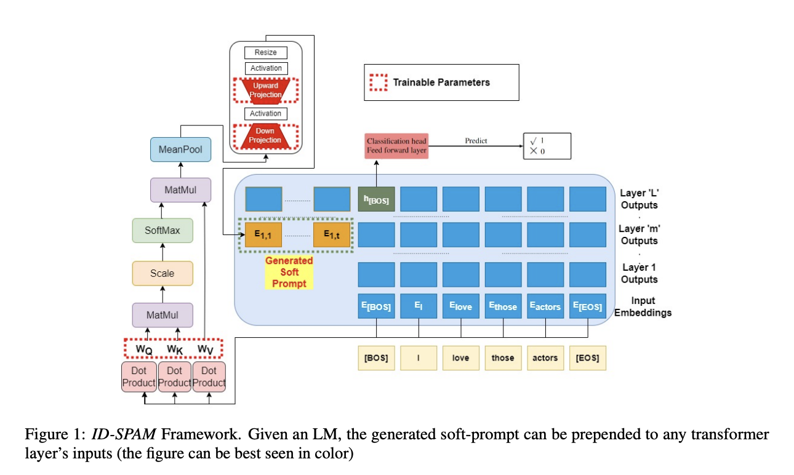
ID-SPAM Architecture

Slide 7
Experimental Setup
Backbones: RoBERTa-BASE and RoBERTa-LARGE
Tasks:
  GLUE: SST-2, MNLI, QNLI, RTE, MRPC, QQP
  SuperGLUE: CB, COPA, MultiRC, BoolQ
Baselines:
  Full fine-tuning, LoRA
  Prompt Tuning, P-Tuning, SMoP, LPT, DEPT

Slide 8
Results: ID-SPAM vs Other Methods
On GLUE, ID-SPAM achieves the best average score among soft-prompt methods for both backbones
With RoBERTa-LARGE, mean GLUE score ≈ 88+, closing much of the gap to full fine-tuning
On SuperGLUE, ID-SPAM again obtains the highest average score over 4 tasks

Slide 9
Zero-Shot Transfer & Ablation Studies
Zero-shot transfer:
  Train on QQP → test on MRPC, and vice versa
  Train on SST-2 → test on IMDB, and vice versa
  ID-SPAM often matches or beats full fine-tuning in these transfers
Ablation:
  Replace self-attention with simple mean-pooling
  Average drop ≈ 5–6 points on RTE/MRPC/QQP
  Shows self-attention is crucial

Slide 10
Limitations & Future Directions
Evaluated mainly on RoBERTa-BASE/LARGE, smaller than current LLMs
Layer choice (where to insert the prompt) is manually tuned
Focused on classification / NLU tasks, not long-form generation
Future:
  Apply to larger LLMs
  Learn insertion layer automatically
  Explore multimodal or generative tasks

Slide 11
Takeaways
ID-SPAM = input-dependent soft prompts via self-attention + MLP
Keeps backbone frozen; trains a small number of parameters
Strong results on GLUE & SuperGLUE vs prior soft-prompt methods
Good zero-shot transfer; often competitive with or better than full fine-tuning
Simple, practical idea to add to the PEFT toolbox

